Slide 1
Vendor Update
Loren Haugh – Vendor Unit Manager

Slide 2
New Faces in the Vendor Unit
William Crenshaw – Vendor Relations Admin Support
Jennifer Jones – Vendor Relations Analyst
Ashley Kreiner – Vendor Relations Analyst
Shawn Gompa – Vendor Relations Analyst
Katherine Groble – Vendor Relations Analyst
William (Bill) Dokianos – Senior Vendor Relations Analyst
Loren Haughn – Vendor Relations Unit Manager

Slide 3
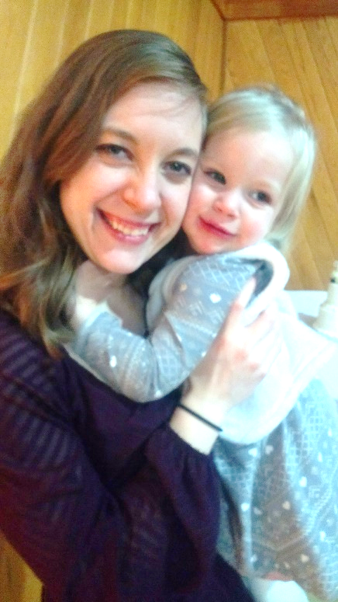
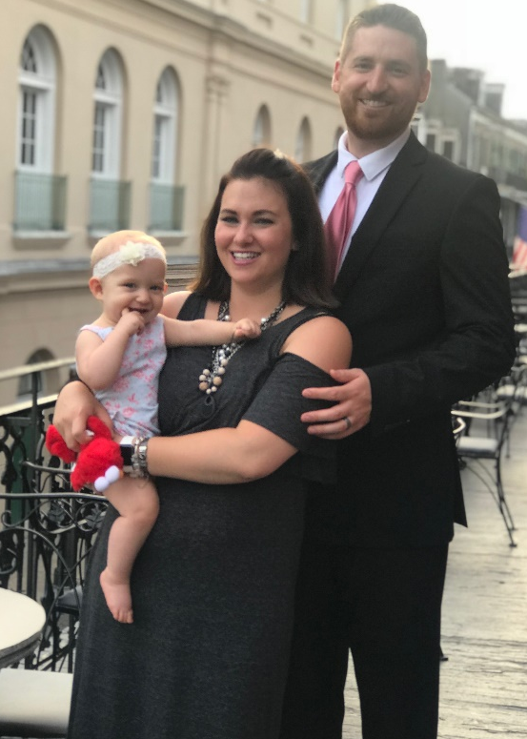
Jennifer Jones
Shawn Gompa
William Crenshaw
Ashley Kreiner
Loren Haughn
Bill Dokianos
Katherine Groble

Slide 4
Vendor Policy Updates
Notes:
Revised Selection Criteria
State Plan changes to enhance participant access reviews
More data, more review, better decisions

Slide 5
Vendor Training
Pre-Authorization Training
Annual Vendor Conference
Interactive Vendor Training
Monitoring Visits
Newsletters
Online Resources
Individual training as need is identified

Slide 6
Vendor Communications
Newsletters
E-mail blasts
Mailings
Phone calls
www.Michigan.gov/WIC
Retail Associations
Notes:
What is the process to communicate with the vendors?

Slide 7
WIC Transactions – Rules and Policies
Does the client need to show ID?
Can a family member use the EBT WIC card?
Can a card number be manually entered?
Why do different stores transact WIC differently?
Notes:
WIC At the Register (Responsibilities)

Slide 8
Tips for working on difficult complaints
Notes:
“How do we deal with store clerks who have no idea what they are doing? Who tell clients that items on the food guide are not covered, etc.”

Slide 9
Resources
Michigan Department of Health & Human Services – WIC Division
Lewis Cass Building, 6th Floor
320 S. Walnut Street
Lansing, MI 48913
Phone: 517-335-8937
Fax: 517-335-9514
Email: MDHHS-WICVendor@michigan.gov
https://www.michigan.gov/WIC
Issues with your Point of Sale (POS) Device
Contact Conduent Customer Service at 1-888-529-1693
Reporting Fraud and/or abuse:
Report this information to 1-800-CALL-WIC or wicfraudinvestigations@michigan.gov
Contacting Michigan Department of Agriculture and Rural Development (MDARD)
Contact by phone: 1-800-292-3939
Contact by e-mail: mda-info@michigan.gov
http://michigan.gov/mdard
SNAP Retailer Information
Toll Free information Number: 1-877-823-4369
HTTPS://WWW.FNS.USDA.GOV/SNAP/RETAILER-TOLL-FREE-INFORMATION-NUMBER-1-877-823-4369

